Slide 1
SERVER LISTENER

Slide 2
Objectives
Webserver event listener introduction
Servlet listener
Session listener
ServletContext listener
<number>/41

Slide 3
Java web server Event
Web events are key moments in web application activity such as initialization of application, destroying an application, request from client, creating/destroying a session, attribute modification in session etc.
Event listener is a component that waits for an event to occur and react to that event by calling the event listener method.
Servlet API provides classes and interfaces to handle lifecycle events of important objects: servlet, session, servlet context
  Each event type will have a corresponding listener class defined by implementing listener interface
For example, we can create a Listener for the application startup event to read context init parameters and create a database connection and set it to context attribute for use by other resources.
<number>/41

Slide 4
Web events and listeners
Event & listener types on Java web application:
  ServletRequestEvent → ServletRequestListener
  ServletContextEvent → ServletContextListener
  ServletRequestAttributeEvent →ServletRequestAttributeListener
  ServletContextAttributeEvent → ServletContextAttributeListener
  HttpSessionEvent → HttpSessionListener
  HttpSessionBindingEvent → HttpSessionBindingListener
    HttpSessionAttributeListener
<number>/41

Slide 5
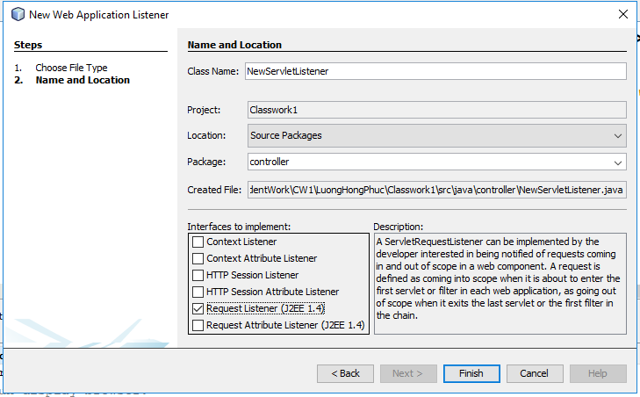
Listener programming
In Netbean, create new web application listener, then select listener type, override the interested method
<number>/41

Slide 6
ServletRequest events-listeners
ServletRequestEvent –indicate lifecycle events for a servlet request
ServletRequestListener
  void requestDestroyed(ServletRequestEvent sre)
  Receives notification that a ServletRequest is about to go out of scope of the web application.
  void requestInitialized(ServletRequestEvent sre)
  Receives notification that a ServletRequest is about to come into scope of the web application
When a servlet request listener is installed, the user request not only calls the requested Servlet but also calls the listener class
<number>/41

Slide 7
ServletRequestAttributeListener
ServletRequestAttributeListener can listen to these events:
  When an attribute is added to an ServletRequest object by invoke request.setAttribute(name, obj)
  →void attributeAdded(ServletRequestAttributeEvent srae)
  When an attribute of an ServletRequest object is replaced by invoke request.setAttribute(name, obj) with new obj.
  → void attributeReplaced(ServletRequestAttributeEvent srae)
  When an attribute of an ServletRequest object is deleted by invoke request.removeAttribute(name)
  → void attributeRemoved(ServletRequestAttributeEvent srae)
ServletRequestAttributeEvent:
  store the name and value information of the attribute
<number>/41

Slide 8
HttpSessionListener
HttpSessionListener can listen to these events
  When an HttpSession is created in a web application by container or invoke request.getSession(true)
  → void sessionCreated(HttpSessionEvent hse)
  When an HttpSession is invalidated in a web application when session timeout or invoke session.invalidate()
  → void sessionDestroyed (HttpSessionEvent hse)
We can perform some operations with this listener such as counting total and current logged-in users, maintain a log of user login time, logout time etc
<number>/41

Slide 9
HttpSessionAttributeListener
HttpSessionAttributeListener –receiving notification events about HttpSession attribute changes:
  void attributeAdded(HttpSessionBindingEvent event)
  void attributeReplaced(HttpSessionBindingEvent event)
  void attributeRemoved(HttpSessionBindingEvent event)
HttpSessionBindingListener is a callback interface that can be implemented by classes which are intended to be added to session. Whenever an object implementing HttpSessionBindingListener is added or removed to session, the callback methods defined on the object is called
The key difference between HttpSessionAttributeListener and HttpSessionBindingListener is that the first listens for any attribute change in session while the second gets notified whenever the same object is added/removed from session
<number>/41

Slide 10
ServletContextListener
ServletContextListener execute code on webapp startup and shutdown:
  void contextInitialized(ServletContextEvent sce)
  Is triggered when the web application is starting the initialization. This will be invoked before any of the filters and servlets are initialized
  void contextDestroyed(ServletContextEvent sce)
  Is triggered when the ServletContext is about to be destroyed. This will be invoked after all the servlets and filters have been destroyed
ServletContextListener may be configured using annotations @WebListener or in web.xml
<number>/41

Slide 11
ServletContextAttributeListener
ServletContextAttributeListener is listen for context attribute change events
The ServletContextAttributeListener has following methods:
  void attributeAdded(ServletContextAttributeEvent scae)
  The servlet container calls this method to notify the listener that an attribute was added to the servlet context.
  void attributeRemoved(ServletContextAttributeEvent scae)
  The servlet container calls this method to notify the listener that an attribute was removed from the servlet context.
  void attributeReplaced(ServletContextAttributeEvent scae)
  The servlet container calls this method to notify the listener that an attribute was replaced in the servlet context.
<number>/41

Slide 12
Event Listener Declaration
Event listeners are declared in the application web.xml deployment descriptor through <listener> elements under the top-level <web-app> element.
Each listener has its own <listener> element, with a <listener-class> sub-element specifying the class name.
Within each event category, event listeners should be specified in the order in which you would like them to be invoked when the application runs.
<number>/41

Slide 13
Event Listener in web.xml
Here is an example of event listener declarations in web.xml:
<web-app>
<listener>
<description>ServletContextListener</description>
<listener-class>controller.AppListener</listener-class>
</listener>
<listener>
<description>HttpSessionListener</description>
<listener-class>controller.SessionListener</listener-class>
</listener>
</web-app>
<number>/41

Slide 14
Coding and Deployment Guidelines
Be aware of the following rules and guidelines for event listener classes:
In a multithreaded application, attribute changes may occur simultaneously. There is no requirement for the servlet container to synchronize the resulting notifications; the listener classes themselves are responsible for maintaining data integrity in such a situation.
Each listener class must have a public zero-argument constructor.
Each listener class file must be packaged in the application WAR file, either under /WEB-INF/classes or in a JAR file in /WEB-INF/lib.
<number>/41

Slide 15
Summary
What are Web Event and Listeners?
Types of web event – listener
Describe event listeners
Event Listener Coding and Deployment Guidelines
<number>/41

